Slide 1
TITLE OF THE PROJECT
E-COMMERCE SALES DASHBOARD

Slide 2
OBJECTIVE
The goal of this project is to build an interactive e-commerce dashboard in Power BI to visualize sales, profit, and quantity metrics.
To provide some analysis in those sales, profit and quantity for data driven business insights.

Slide 3
TOOLS AND TECHNOLOGIES
The main tool used is POWER-BI
Microsoft Excel is used as the data-set tool.

Slide 4
DATASET USED
The dataset includes the data extracted from excel which consists of 2 tables:
DETAILS TABLE- This table includes data consisting of 1500 rows,having columns like Amount,Category, Order-Id,Payment mode,Profit,Quantity and Sub-category
ORDERS TABLE-This table includes 500 rows and 5distinct columns called Order-Id, Order-date,Customer name,State and City.

Slide 5
METHODOLOGY
Data extraction from Excel.
By importing csv file of Details and Orders into Power-Bi Desktop
Data transformation :
It is done by using Power Query Editor by connecting 2 tables used joining techniques to connect Details and Orders using common column name-Order-Id.

Slide 6
METHODOLOGY
Insights generation using DAX Formulae
Created DAX Formulae for Total Sales/Total Revenue, Total Profit, Total Quantity Sold, Average Order Value.
The formulae for each measures is listed below:
Total Revenue = SUMX(Details, Details[Amount] * Details[Quantity])
Total Profit = SUM(Details[Profit])
Total Quantity Sold = SUM(Details[Quantity])
Average Order Value = Details[Total Revenue]/Details[Total Orders]
Used colorful slicers, KPI, Charts and prepared a interactive Dashboard.

Slide 7
FEATURES IMPLEMENTED
KEY PERFORMANCE INDICATORS(KPI’S):
Total Sales,
Total Profit,
Total Quantity Sold,
Average order value.

Slide 8
FEATURES IMPLEMENTED
CORE VISUALIZATIONS:
Quarter Filter: Added a slicers for quarters Q1, Q2, Q3,Q4
Bar Chart: Explains Sum of profit by month.
Horizontal Bar Chart: Displays Total Sales State wise and also shows Profit v/s sub-category
Donut Chart: Visualized Quantity by Category and Payment Mode Distribution.
Stacked Column Chart: Shows Sales by Customer.

Slide 9
INTERACTIVITY ADDED TO THE FEATURES OF DASHBOARD
Set Up Drill-Downs: Enabled drill-downs for category and state by creating hierarchical data for category column to allow users to see detailed data on clicking.
Tooltips: Customize tooltips is being added to show some additional visuals when hover to particular visualization.
Data Validation: Verified all data connections and relationships are correct as per the knowledge.
Filters and Slicers: Test filters to ensure charts update dynamically when filtered.

Slide 10
RESULTS/INSIGHTS
In E-Commerce Sales Dashboard we can come to conclusion that Category Clothing pays the most top selling product, that too in state of Madhya Pradesh its selling high.
And also if category clothing sales are high the sub-category related to clothing we can see profit high when hover to category in donut chart.
We can also see Q1, trends to be the highest sales and profit for the category and subcategory of all the places.

Slide 11
CHALLENGES FACED
Faced some issues while merging 2 tables Details and Orders because if we connect the table only we can analyze and perform calculations else keeping single table data is difficult to analyze.

Slide 12
CONCLUSION
This project of E-Commerce Sales helped me to analyze various insights.
Learned to create DAX queries and transformed 2 tables using power query editor.
Implemented joining techniques and it overall improved my dashboard creation skill for business driven insights and storytelling process.

Slide 13
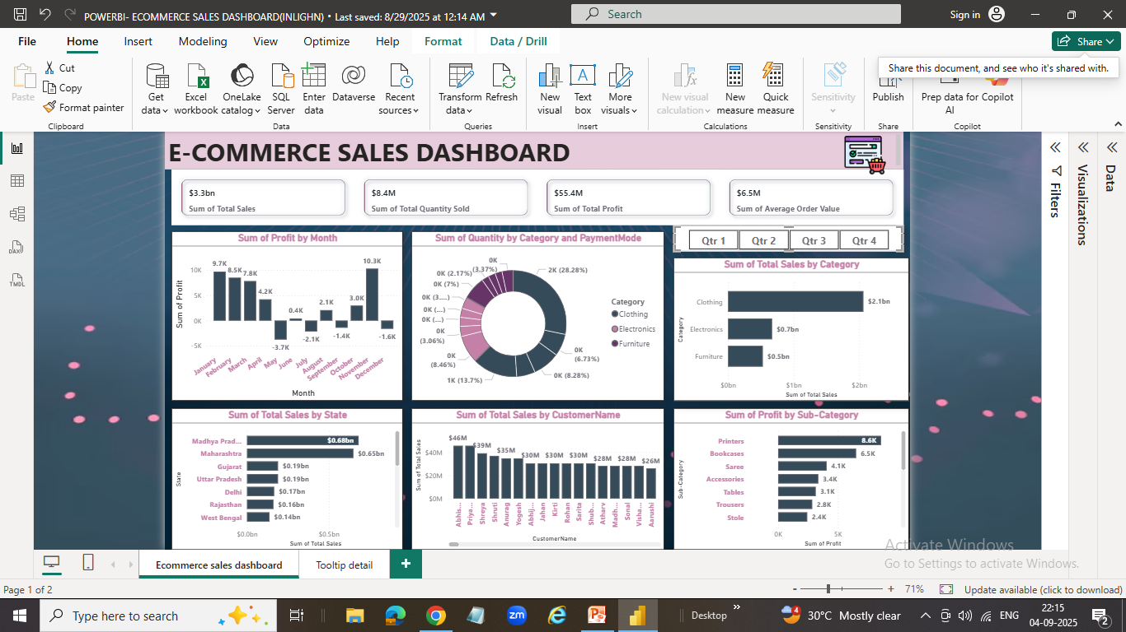
SCREENSHOTS
Notes:
THIS IS MY E-COMMERCE SALES DASHBOARD

Slide 14
LINK TO GITHUB OR POWERBI REPORT
🌐 GitHub:
http://github.com/AkshayaAshok28/POWER-BI-PROJECT

